Slide 1



NETFLIX STOCK PRICE PREDICTION
MID-TERM REPORT
TEAM MEMBERS: 狄苏菲, 伯汀娜
TIME: 2024/10/12

Slide 2

Outline:
Step 1: Importing libraries
Step 2: Data loading
Step 3: Data preparation
Future goals

Slide 3
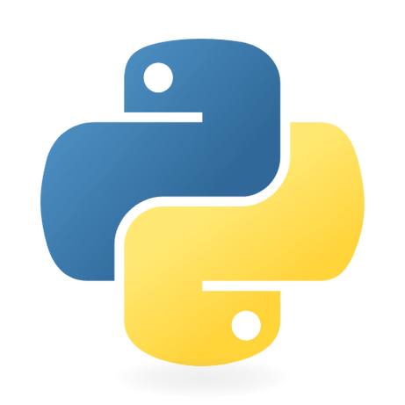
STEP 1: Importing libraries
NumPy is used for working with arrays, matrices, and mathematical operations;
Pandas is used for data manipulation, providing data structures like DataFrames for convenient data handling and analysis;
Matplotlib is used for creating various types of plots and visualizing data;
By using Scikit-learn library it’s easier to split the dataset, to create a linear regression model and count various metrics for evaluating the performance

Slide 4
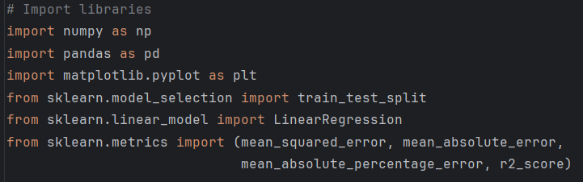
STEP 1: Importing libraries

Slide 5

STEP 2: Data loading
In this step we are loading the data from a CSV file into a Pandas DataFrame and getting basic information about the dataset and its structure.
After that we are creating a deep copy so the original dataset will not be effected.

Slide 6
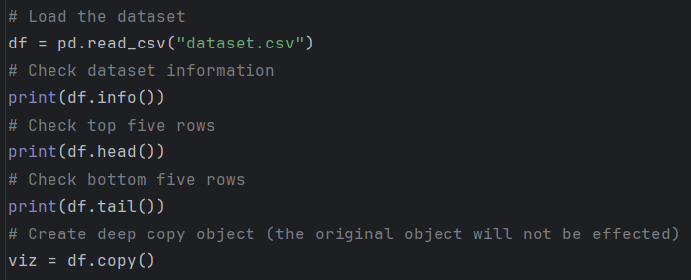
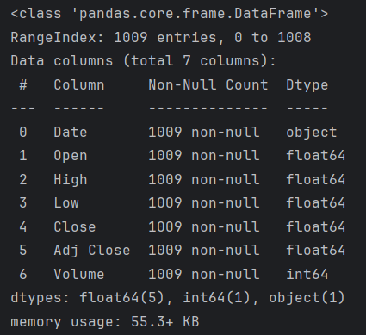
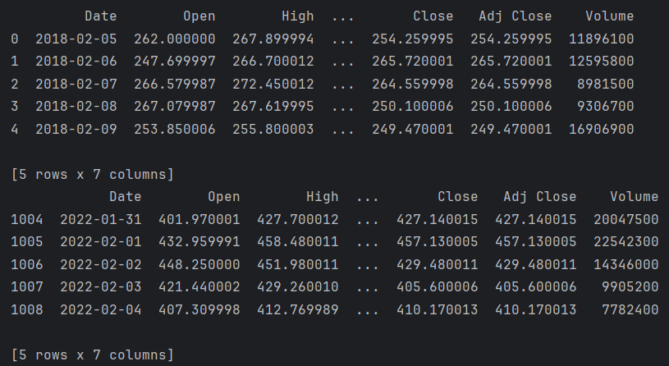
STEP 2: Data loading

Slide 7


STEP 3: Data preparation
In this step we:
Сheck the dataset for missing values;
Separate features (input variables) and the target variable (closing price);
Split the data into training and testing sets for model training and evaluation.
CONTINUE

Slide 8
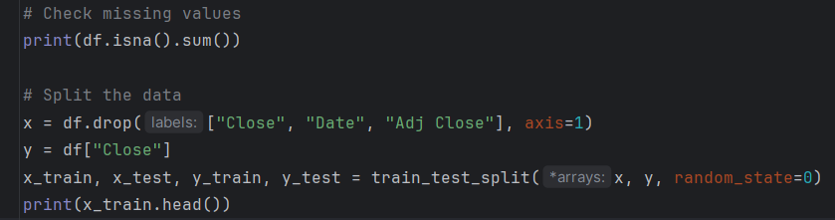
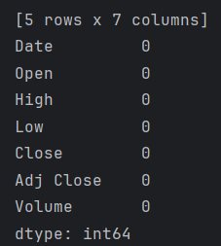
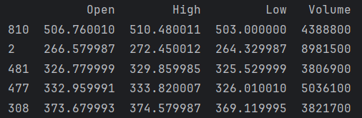
STEP 3: Data preparation

Slide 9

Future goals
Step 4: Linear regression
Step 5: Evaluate the model
Step 6: Visualize the model
Step 7: Saving the Data as CSV
CONTINUE

Slide 10


Thank you

